Slide 1

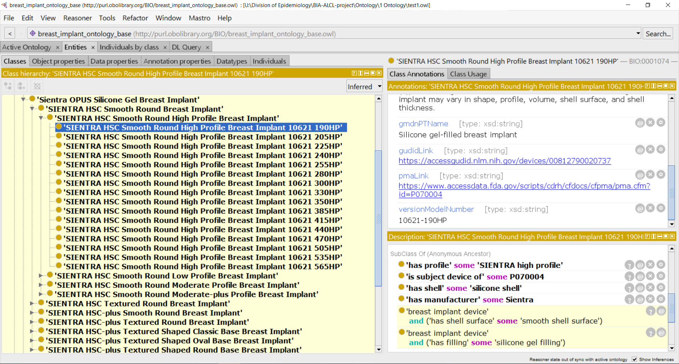
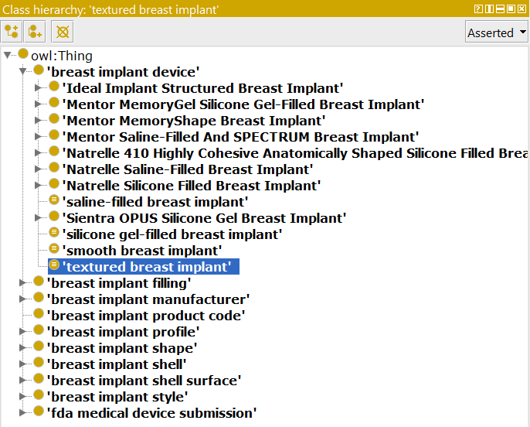
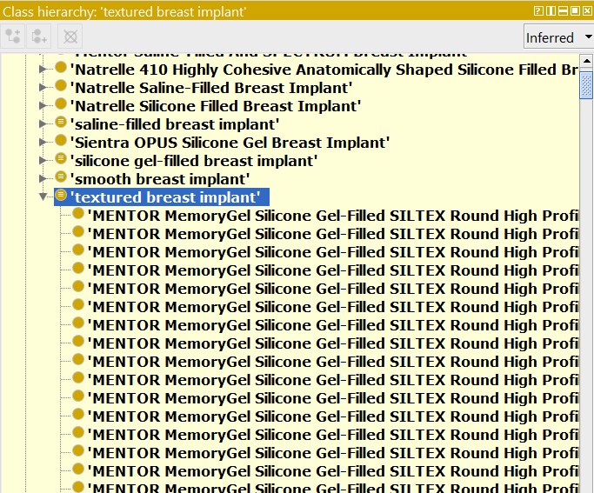
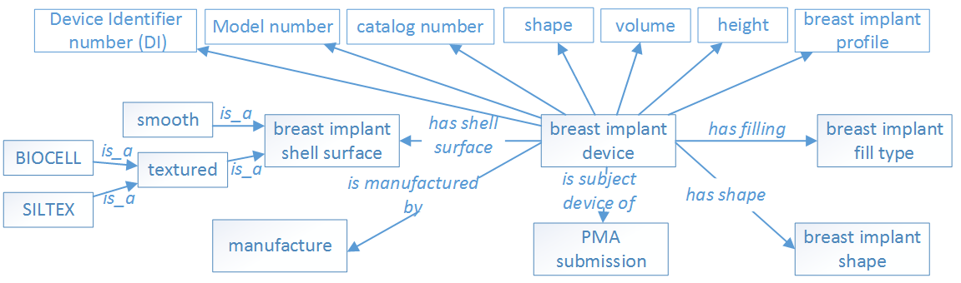
Building a Comprehensive Breast Implant Ontology Leveraging GUDID and Unstructured Data Sources
Mark Jung^{1,2}, Michael Wu^{1,3}, Asiyah Yu Lin¹, Hongying (Helen) Jiang¹, Weiguang Wang¹, Zhou Feng¹, Dongyi (Tony) Du¹, Nilsa Loyo-Berrios¹
¹FDA/CDRH/Office of Surveillance and Biometrics, Silver Spring, MD 20993
²Montgomery Blair High School, ³Wheaton High School
Background
Results
Individuals with breast implants have a risk of developing breast implant-associated anaplastic large cell lymphoma (BIA-ALCL), which appears to be more prevalent in breast implants (BI) that have textured surface than smooth surface from the literature. However, both FDA device product codes and Global Medical Device Nomenclature (GMDN) do not provide the terms for breast implants surface types. This significantly hinders the data analysis of the possible association between the breast implant surface types and BIA-ALCL. A Breast Implant Ontology can categorize all the breast implant products and their features/attributes under an ontological structure, which can be used by a semantic reasoner tool to automatically classify breast implants features (e.g. smooth or textured surface types). This ontology can also be used as a backend dictionary for a text mining tool to help explore the patterns/trends from BIA-ALCL cases reported in the MDR or other data sources.
An initial ontology design pattern was created to layout the attributes of the breast implants and how they will be related to each other (Figure 1).
The Breast Implant Ontology (BIO) arranged a total of 1738 breast implant products from GUDID as lowest level terms under the hierarchical ontology structure. The top level is the 8 FDA approved breast implants with unique PMA number. The 2nd level are brand names for each PMA number associated breast implants. Under brand names, it is styles of breast implants if provided by sponsor’s catalogs. Besides the features shown in the design pattern, the product code, device catalog number, version model number, GUDID link, PMA link, GMDN name, and GMDN definition, and GUDID publish dates were included in the ontology. (Figure 2)
Several artificially defined classes (“Saline-filled breast implant”, “silicone gel-filled breast implant”, “smooth breast implant” and “textured breast implant”) were created in the BIO to facilitate the automatic classifications. For example, one can define a class ‘textured device’, given axioms that it must be a ‘breast implant device’ and must have a ‘textured shell surface’, resulting in the automatic population of ‘textured device’. In Protégé’s syntax, this is represented as “breast implant” and (has_shell_surface some textured_surface)
An automated reasoner ELK was used for automatic ontology classification, making inferences based on given logic axioms (Figure 3). After reasoning, the BIO ontology classified 906 textured breast implants, and 836 smooth breast implants from GUDID.
Objective
The objective of our project is to create an extensive ontology to categorize the different breast implants and their product features, including but not limited to: manufacturer, brand, filling, and so on. The ontology will help FDA determine possible relationships between BI features and patient symptoms that correspond with BIA-ALCL.
Figure 2. Class Tab in Entities View in Protégé 5
Individual devices (lowest level classes) are subclasses of specific relationships (e.g. ‘has profile’ some ‘SIENTRA high profile’) and are also annotated with additional information, e.g. GUDID link and version model number.
Methods
A. Before reasoning
B. After reasoning
Two kinds of data sources were used: the structured data from FDA’s Global UDI Database (GUDID), and the unstructured data from product catalogs per sponsor. Breast implant data on implant characteristics were gathered primarily from GUDID database using the FDA product codes FWM and FTR. Current catalogs from four breast implant sponsors were also used for cross-verification of data as well as providing additional information, such as device dimensions, diameters, heights, projection, etc.
Tools, including python, Protégé, and an ontology editor, were used to engineer the ontology. Python libraries — including NumPy and Pandas – were used for piping relevant data through various data-capture filters into a compiled Excel file. The Python Owlready2 library was modified to load all content from the excel sheets into the ontology. In addition to visualization, the Protégé was used to perform reasoning to check consistency and conduct automatic classification based on the logic definitions created in the ontology.
Figure 3. Before (A) and after (B) running the ELK reasoner on the Breast Implant Ontology
Defined classes, e.g. ‘saline-filled device’, ‘silicone gel-filled device’, ‘smooth device’, and ‘textured device’, need not be manually populated; instead, supplying the relevant axioms to an automated reasoner allows it to infer subclasses.
Conclusion
The current BIO is a preliminary ontology for breast implant. It includes all the GUDID breast implants, which are the products on the market. To make BIO useful for the text mining on MDR datasets, off-market historical breast implants need to be added. Future work also includes adding device dimension measurements, such as width/diameter, height, nominal fill volume, maximum fill volume, nominal projection, and max projection into the ontology. BIO will also be released as an open source to other stakeholders, e.g. researchers, industries, and organizations.
Acknowledgements
Disclaimer
Authors want to acknowledge the valuable support from OSB and DSD teams, particularly Danica Marinac-Dabic, Binita S Ashar, Karen Nast, Sung Yoon, Trisha Eustaquio, and Tajanay Ki.
The views expressed are the authors’ and not necessarily those of the Food and Drug Administration, or the Department of Health and Human Services.
Figure 1. Initial ontology design pattern
www.fda.gov

